Slide 1

A review of the care provided to patients aged 16 and over with a diagnosis of Crohn’s disease who underwent a surgical procedure
Making the Cut?
Key messages and recommendations
Notes:
Presenter’s notes:
This presentation can be used to present the key messages recommendations from the report ‘Making the Cut?’ This looked at care received by patients aged 16 and over, with a Crohn’s disease diagnosis who underwent a surgical procedure. NHS hospitals in England, Wales and Northern Ireland were invited to provide data for the study.
More information can be found at www.ncepod.org.uk/2023crohns.html

Slide 2
The study
To identify remediable factors in the quality of care provided to patients aged 16 and over with a diagnosis of Crohn’s disease who underwent an abdominal surgical procedure.
Organisational questionnaire
Clinician questionnaire
Case note review
Patient online survey
Notes:
Presenter’s notes:
The study described in this report aimed to identify remediable factors in the quality of care provided to patients aged 16 and over with a diagnosis of Crohn’s disease who underwent an abdominal surgical procedure.
A questionnaire was sent to the named consultant surgeon responsible for the patient’s care at the time of the hospital admission.
Case notes were reviewed by clinicians in colorectal surgery, gastroenterology, anaesthetics, radiology, dietetics and inflammatory bowel disease nursing that work with people with Crohn’s disease.
The anonymous patient surgery was circulated online to allow Crohn’s disease patients who have undergone surgery to provide their views on the care received as an inpatient.

Slide 3
Study population
Inclusion criteria
Patients aged 16 years and older, who had a diagnosis of Crohn’s disease and an elective or emergency admission to hospital for a stay of 48 hours or longer during which time they underwent intestinal surgery.
Sampling period
1st September 2019 to 29th February 2020 inclusive (prior to the COVID-19 pandemic, as cases were rising) and 1st September 2020 to 28th February 2021 inclusive (including the peak of the COVID-19).
Notes:
Presenter’s notes:
Crohn’s disease ICD10 codes: K50-50.9.
OPCS codes: G58-G83 or H01-H6
Exclusion criteria
Patients who did not have Crohn’s disease or whose surgery did not relate to their Crohn’s disease.

Slide 4
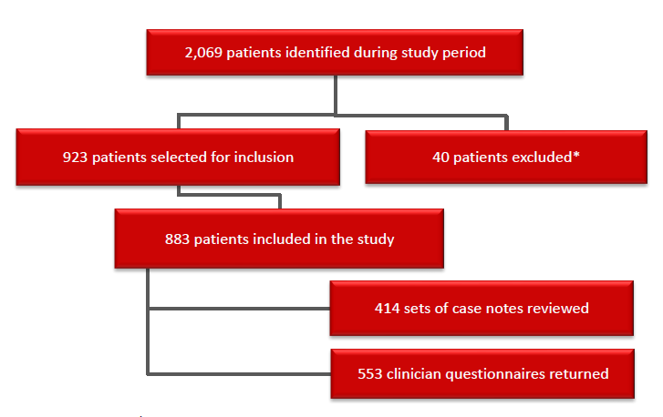
Study sample
Figure 1. shows the number of patients included in the study and the data returns.
Notes:
Presenter’s notes:
Clinical data
In total 2,069 patients were identified as meeting the study inclusion criteria. 923 patients were selected for inclusion in this study. Analysis was undertaken on questionnaires from 553 clinicians and 414 sets of case notes,
Organisational questionnaires were also received from 138/210 (65.7%) participating hospitals.
A total of 316 patient surveys were completed providing qualitative data.

Slide 5
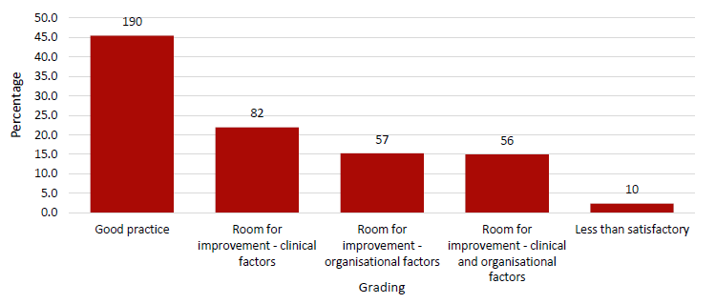
Overall assessment of care
Figure 2. Overall quality of care
Reviewer assessment form data
Notes:
Presenter’s notes:
The case reviewers assessed the overall quality of care for each case reviewed.
In total, 190/414 (45.9%) cases were assessed as good practice, room for improvement in clinical care in 138/414 (33.3%) cases and in organisational factors in 113/414 (27.3%) cases.

Slide 6
Key messages (1)
Provide holistic support for all patients with Crohn’s disease
Patients with Crohn’s disease have many wider health needs e.g. psychological, dietary and peer support.
Notes:
Supporting evidence:
The reviewers found evidence of psychological support across the care pathway in just 30/332 (9.0%) cases reviewed, even though patients had undergone major surgery.
Services that the patients would have liked but did not receive included psychological support (132/310; 42.6%) and dietetic support (108/310; 34.8%).

Slide 7
Key messages (2)
Medication for Crohn’s disease should be managed effectively at all stages of the pathway
This would ensure patients are taking the correct medication before, during and after surgery.
Notes:
Supporting evidence:
253/414 (61.1%) patients were taking medications for their Crohn’s disease, and of these, complications or side effects of the medication were recorded in 38/253 (15.0%).
There was room for improvement in the management of medication for 45/222 (20.3%) patients e.g. the use of prophylaxis (15) and/or a delay in starting/reviewing medication (10).

Slide 8
Key messages (3)
Consider surgery as a potential treatment option for patients with Crohn’s disease
Surgery should not be perceived as a failure of medical management and could be undertaken sooner.
Notes:
Supporting evidence:
Reviewers reported that referral for a colorectal surgical opinion should have occurred earlier in 41/218 (18.8%) patients.
56/278 (20.1%) patients, identified in the reviews, encountered more than one delay in the elective surgery pathway and 14/34 patients had adverse outcomes due to complications and the need for a stoma.

Slide 9
Key messages (4)
Perform surgery promptly once a decision to operate has been made.
This would prevent elective patients becoming emergencies and reduce the risk of a Crohn’s flare when medications are altered pre-operatively.
Notes:
Supporting evidence:
128/301 (42.5%) patients waited more than 18 weeks (126 days) before their operation was carried out (unknown for 63) and 30/311 (10.0%) patients waited more than six months for surgery.
Only 18/138 (13.0%) hospitals reported local targets in place for the scheduling of Crohn’s disease surgery.

Slide 10
Key messages (5)
Make sure that the handover of carer from the surgical team to the medical team is robust.
Early involvement by the inflammatory bowel disease team would promote joined up care after surgery.
Notes:
Supporting evidence:
299/553 (54.1%) patients saw neither an inflammatory bowel disease (IBD) nurse nor a gastroenterologist postoperatively.
Re-adjustments of Crohn’s disease medication may be required after surgery to reduce the postoperative risks of immunosuppression, yet a pharmacist was only involved for 258/553 (46.7%) patients.

Slide 11
Recommendation 1
Ensure that all patients with Crohn’s disease can access the holistic care they need.
A patient passport that summarises the patient’s care may help and could include information on the aspects listed above.
Primary target audience: Clinical directors for gastroenterology and clinical directors for colorectal/gastrointestinal surgery.
Supported by: All members of the multidisciplinary team caring for patients with Crohn’s disease.
Notes:
Presenter’s notes:
Twelve recommendations were formed by a consensus exercise by all those involved in the study.
The recommendations highlight areas that are suitable for regular local clinical audit and quality improvement initiatives providing care to this group of patients.
This should include:
a. Medication management, including specialist pharmacist support*
b. Management of steroid withdrawal syndrome (adrenal suppression)**
c. Information on what to do in the event of a Crohn’s disease flare
d. Pain management
e. Stoma care
f. Anaemia prevention and treatment
g. Access to peer support
h. Access to psychological support
i. Access to dietetic support
j. Support for wider health needs such as fertility issues
k. Smoking cessation services
l. Any other relevant lifestyle modification services
*This aligns with the IBDUK inflammatory Bowel Disease Standards
**This aligns with NICE Guideline 129 - Crohn’s Disease Management and the British Society of Gastroenterology Consensus Guidelines on the Management of Inflammatory Bowel Disease

Slide 12
Recommendation 2
Optimise medications for patients with Crohn’s disease. This should include review of:
a. The prescription and/or discontinuation of steroids, biologics and immunomodulators
b. The use of steroids, with specific reference to bone protection, and when to use proton pump inhibitors (PPIs)
c. The provision of a steroid treatment card for all patients receiving steroids for more than three weeks*
d. For patients undergoing scheduled surgery, a pre-operative medication review at the point the decision to operate is made
e. The avoidance of 5-ASA for the treatment of Crohn’s disease**
Primary target audience: Consultant gastroenterologists, consultant colorectal/ gastrointestinal surgeons, inflammatory bowel disease nurses, and inflammatory bowel disease pharmacists.
Supported by: Clinical directors for gastroenterology and clinical directors for colorectal/ gastrointestinal surgery.
Notes:
*This aligns with the NICE clinical knowledge summary on corticosteroids
**This aligns with the British Society of Gastroenterology Consensus Guidelines on the Management of Inflammatory Bowel Disease

Slide 13
Recommendation 3
Ensure that the members and timing of the multidisciplinary team meetings for patients with Crohn’s disease adheres to current inflammatory bowel disease standards.
Primary target audience: Clinical directors for gastroenterology and clinical directors for colorectal/ gastrointestinal surgery.
Supported by: All members of the multidisciplinary team caring for patients with Crohn’s disease.

Slide 14
Recommendation 4
Document all multidisciplinary team discussions in the patient’s clinical record at the time of the meeting and provide a summary to the patient and their GP.
Primary target audience: Multidisciplinary team lead.
Supported by: Supported by consultant gastroenterologists, consultant colorectal/ gastrointestinal surgeons, and inflammatory bowel disease nurses.

Slide 15
Recommendation 5
Refer patients for surgical consideration when treatment with medication alone does not work. This is not an indication of 'failed medical management.’
Primary target audience: Consultant gastroenterologists.
Supported by: All members of the multidisciplinary team caring for patients with Crohn’s disease, clinical directors for gastroenterology, colorectal/ gastrointestinal surgery, and directors of nursing who are setting the local policies, and national/specialty guideline producing organisations.

Slide 16
Recommendation 6
Review patients with Crohn’s disease, who are undergoing elective surgery, in a consultant-delivered, pre-operative assessment and optimisation anaesthetic clinic. This appointment should include an updated nutritional status assessment with input from dietitians and other specialties as needed.
Primary target audience: Consultant anaesthetists.
Supported by: Clinical leads for gastroenterology, and dietetics and all other relevant members of the multidisciplinary team caring for patients with Crohn’s disease.

Slide 17
Recommendation 7
Perform abdominal surgery for patients with Crohn’s disease within one month of the decision to operate.*
Primary target audience: Consultant colorectal/ gastrointestinal surgeons.
Supported by: Clinical directors for colorectal/gastrointestinal surgery and medical directors.
Notes:
*This aligns with guidance from the Federation of Surgical Specialty Associations but the timeframe may be adapted if essential to optimise a patient’s condition or to accommodate patient preferences. However, cancellations should be avoided as these increase the risk of complications as biologics, immunomodulators and steroids may have been altered for a planned date of surgery.

Slide 18
Recommendation 8
Investigate, and take appropriate action as necessary e.g. report as a serious incident, when a patient with Crohn’s disease on an elective surgery waiting list undergoes emergency surgery for a complication of their Crohn’s disease.
Primary target audience: Medical directors.
Supported by: Clinical directors for colorectal/gastrointestinal surgery, clinical directors for gastroenterology, and all relevant members of the multidisciplinary team caring for patients with Crohn’s disease.

Slide 19
Recommendation 9
Plan for the postoperative discharge of patients with Crohn’s disease including:
a. Handover of care to the inflammatory bowel disease/gastroenterology team who will look after the patient’s ongoing medical care
b. Undertaking a medication review*
c. Providing information to the patient on who to contact in the event of an emergency
d. Providing information to the patient on pain management, including what can be taken, not just what to avoid
e. Booking follow-up appointments
f. Providing information to the patient on how to access to psychological support if needed
g. Communicating all of the above to the patient and their GP
A structured discharge summary could help facilitate this.
Primary target audience: Consultant colorectal/gastrointestinal surgeons.
Supported by: Consultant gastroenterologists, the chief pharmacist, and other members of the multidisciplinary team caring for patients with Crohn’s disease.
Notes:
*Pharmaceutical discharge planning should start at admission by the ward pharmacy team, under the supervision of the inflammatory bowel disease pharmacist. Any changes should be communicated to the patient’s GP and inflammatory bowel disease team.

Slide 20
Recommendation 10
Develop a trust/health board policy for the care of patients with Crohn’s disease.
Primary target audience: Medical directors, directors of surgery, and directors of nursing.
Supported by: Chief Executives and members of the multidisciplinary team caring for patients with Crohn’s disease.
Notes:
This should include:
a. The co-ordination of care between medical and surgical teams
b. Support for the multidisciplinary team process
c. Prioritisation of surgical treatment
d. An appropriate consent process for surgery
e. Pre-optimisation/ assessment of patients scheduled for surgery
f. Medication management
g. Nutritional assessments and support
h. Pain management;
i. Psychological support
j. Discharge planning
This recommendation aligns with the IBDUK inflammatory Bowel Disease Standards and the British Society of Gastroenterology Consensus Guidelines on the Management of Inflammatory Bowel Disease

Slide 21
Recommendation 11
Define the services and facilities that constitute a surgical inflammatory bowel disease centre in order to commission high quality care (see also recommendation 10).
Primary target audience: National and local commissioners.
Supported by: Trust/health board medical directors, directors of surgery, and directors of nursing, members of the multidisciplinary team caring for patients with Crohn’s disease, and with guidance from the IBDUK inflammatory Bowel Disease Standards.

Slide 22
Recommendation 12
Develop guidelines to ensure temporary stomas are closed within 12 months of their formation unless there is a documented reason to justify delay.
Primary target audience: Association of Coloproctology of Great Britain and Ireland.
Supported by: Consultant colorectal/gastrointestinal surgeons, and commissioners.

Slide 23
Discussion
Are the holistic care needs of patients being appropriately met?
Are Crohn’s disease patients having their medications optimised? Do we have a policy locally to support this?
Are abdominal surgery for Crohn’s disease patients being performed within 1 month of the decision to operate? Do we have a policy locally to support this?
Is there a guideline locally for the care of patients with Crohn’s disease? If yes, what does this include?

Slide 24
Making the Cut?
Full report, summary and implementation tools are be found at
www.ncepod.org.uk/2023crohns.html
Notes:
www.ncepod.org.uk/2023crohns.html

